Slide 1


Institute for Advanced Computing and Software Development (PG-DAC)
Car Rental System
Project By :-
Mr. Manish Jaiswal (219104) Mr. Omkar Kolge (219118)
Project Mentor
Mrs. Sonali Mogal
Project Guide
Mr. Milind Arjun

Slide 2
Introduction
CAR RENTAL SYSTEM (CRS) is a web-based system for a company that rents out cars. This system enables the company to make their services available to the public through the internet and also keep records about their services.
One of which is the main target of this project which is about Car Rental System. The system of renting cars exist back in the previous years, were people rent cars for their personal reasons. Car renting is essential to many peoples’ plan to travel or move from one place to another for business purposes, tour, and visit or holidays, for these reasons Car renting is very helpful.

Slide 3
Scope
The system will be mainly design for large, premium and small car rental business.
The car rental system to keep records of both the cars and the users, the duration they rent car as well as the type of car they rent.
The system able to provide the better services to their users from time-to-time.

Slide 4
Technology
We used Java Spring-Boot as backend and React JS as Frontend in our Project.
Spring-Boot :–
The main goal of the Spring Boot framework is to reduce overall development time and increase efficiency. React has become the first choice for frontend because it gives developers the ability to work with a virtual browser (more friendly than the real browser). Also, a JavaScript developer can become a productive developer in a few hours because there is a small API to learn, a few functions, and how to use them…
React :–
React allows developers to create large web applications that can change data, without reloading the page. The main purpose of React is to be fast, scalable, and simple. Spring

Slide 5
Modules
Admin
Employee
User

Slide 6
ADMIN
After sign up the admin able to view admin Dashboard. After see all the functionality like car Availability in which the admin will be able to view all the cars available in the system, add car in able to add the cars. Remove remove the cars from the system, Edit profile make the changes by changing the name passwrd and mob_no, payment history payment and the status of the booking, feedback/rating List feedback and rating given by the user.
ADMIN
Car
Availability
Add Car
Remove Car
Payment
History
Feedback/
Rating List
Edit Profile

Slide 7
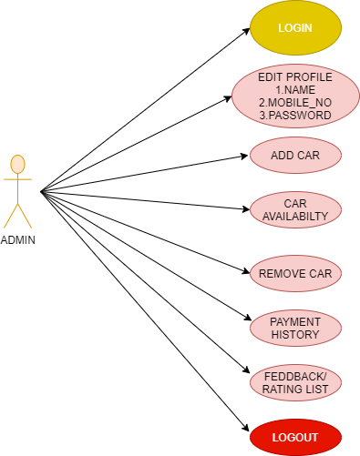
USE CASE DIAGRAM FOR ADMIN

Slide 8
EMPLOYEE
Car Availability Employee will be able to view all the cars available. Booking list the employee will be able to view to view the users booking list.
Remove Car able to remove the cars, edit profile Employee will be able to make the changes by changing the name password and mobile no
Employee
Car
Availablity
Remove
Car
Edit Profile
Booking
List

Slide 9
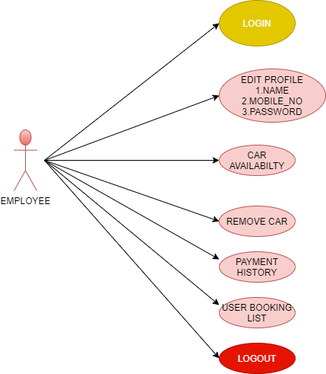
USE CASE DIAGRAM FOR EMPLOYEE

Slide 10
USERS
Car Availability User will be able to view all the cars available, Book Car available cars user will be able to book the car according to his choice, Manage Booking User can view the booking list and even cancel the booking , Edit Profile User will be able to make the changes by name password and mobile no Feedback in this the user will be able to give the feedback and rating for the booking
User
Car
Availability
Book Car
Manage
Booking
Edit Profile
Feedback

Slide 11
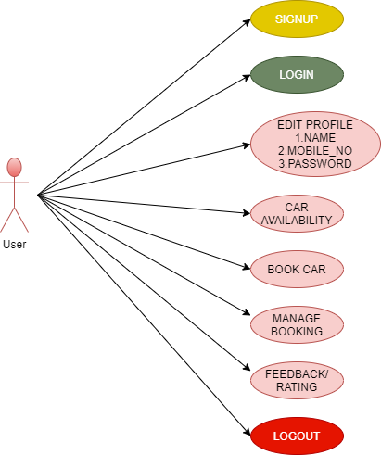
USE CASE DIAGRAM FOR USERS

Slide 12
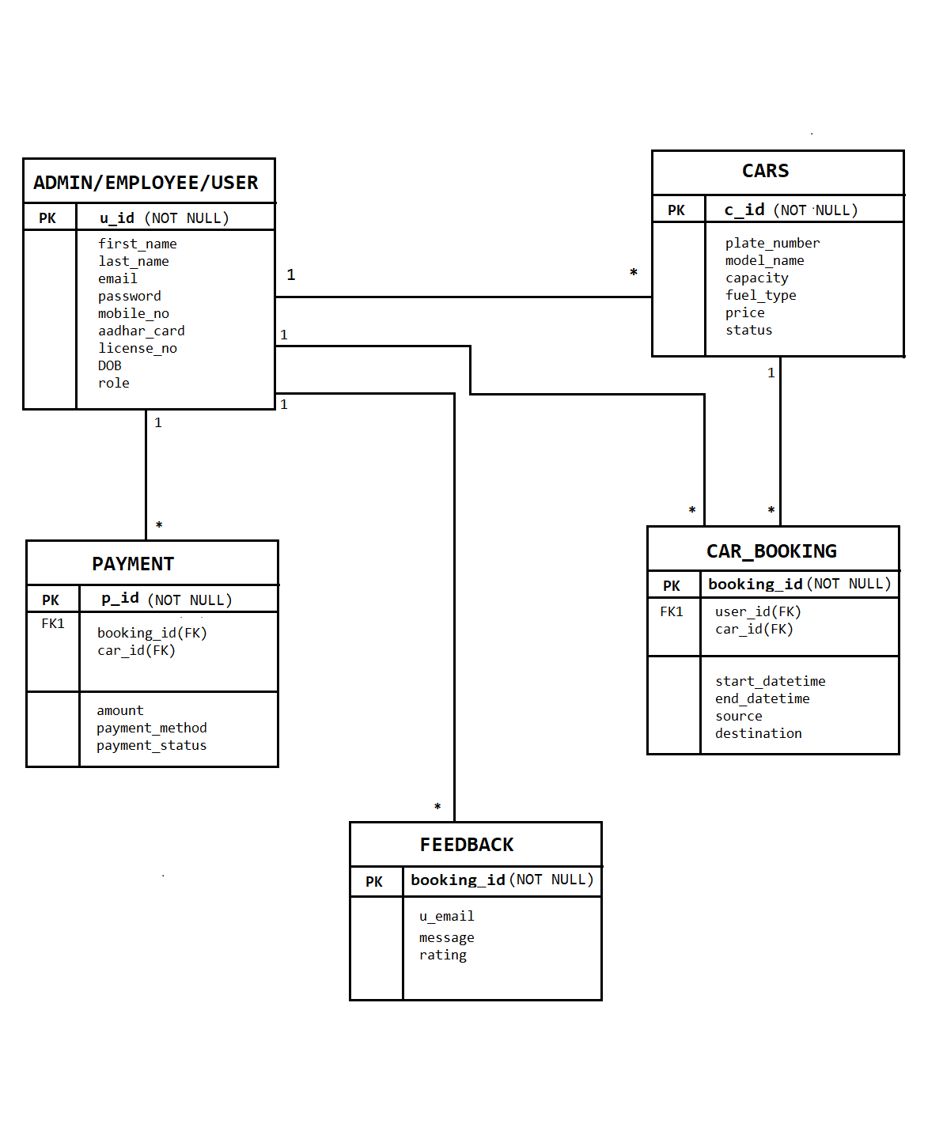
ER-DIAGRAM

Slide 13
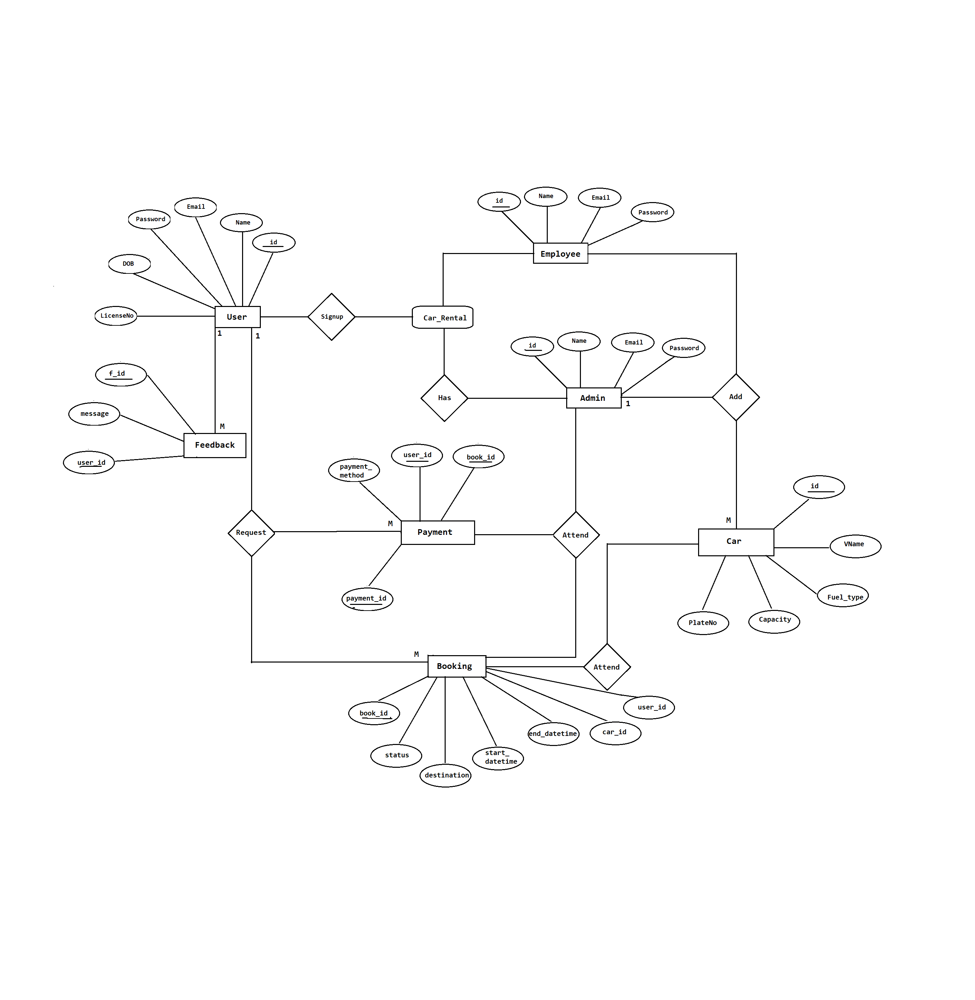

Slide 14
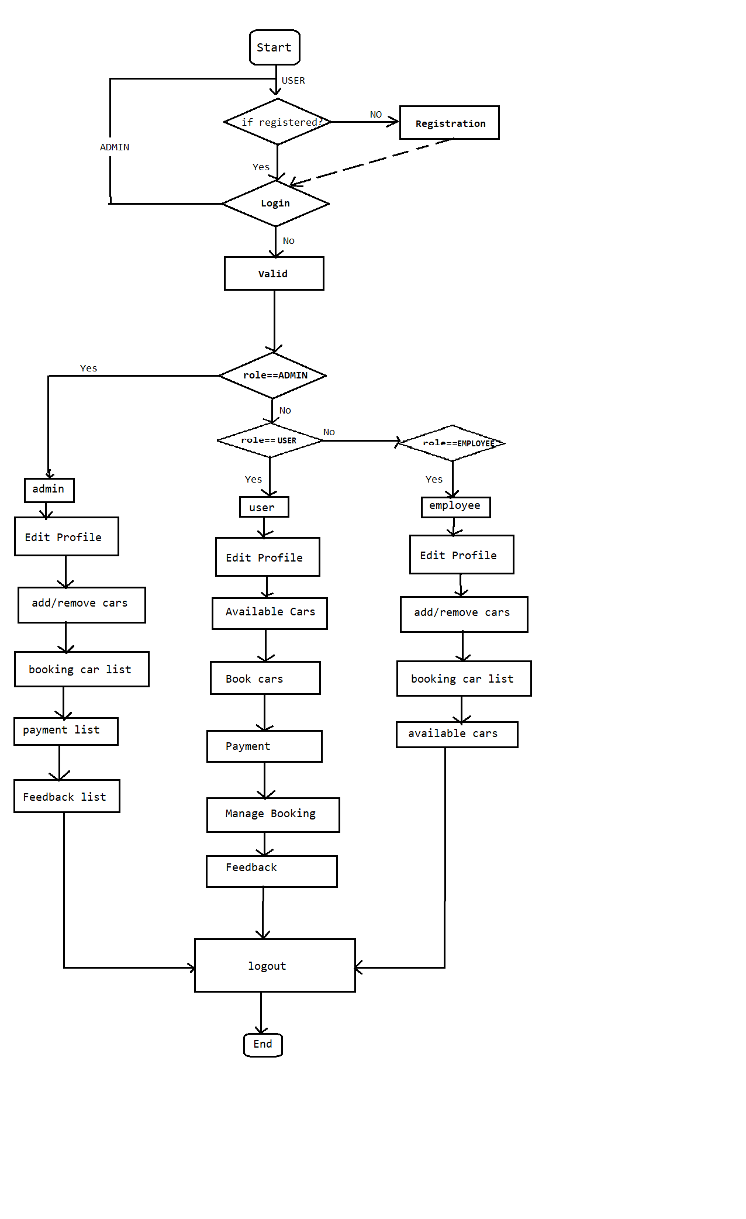
DATA FLOW DIAGRAM

Slide 15
Table 1: Users
Key Type/ Constraint | Column Name | Data Type | Length | Allow Null (1=Yes;0=No)
PRI | u_id | int | - | 0
0 | aadhar_card | varchar | 15 | 0
0 | dob | date | - | 1
UNI | email | varchar | 25 | 1
0 | licence_no | varchar | 15 | 0
0 | mobile_no | varchar | 13 | 1
0 | name | varchar | 30 | 1
0 | password | varchar | 20 | 0
0 | role | varchar | 255 | 1

Slide 16
Table 2: Car_Booking
Key Type/ Constraint | Column Name | Data Type | Length | Allow Null (1=Yes;0=No)
PRI | c_id | int | - | 0
0 | capacity | int | - | 1
0 | fuel_type | varchar | 30 | 1
0 | model_name | varchar | 15 | 1
UNI | plate_number | varchar | 20 | 0
0 | price | double | - | 1
0 | status | varchar | 255 | 1
0 | is_deleted | Bit | 1 | 1

Slide 17
Table 3: Car_Booking
Key Type/ Constraint | Column Name | Data Type | Length | Allow Null (1=Yes;0=No)
PRI | booking_id | int | - | 0
0 | destination | varchar | 30 | 1
0 | end_datetime | date | - | 1
0 | source | varchar | 30 | 1
0 | start_datetime | date | - | 1
MUL | car_id | int | - | 1
MUL | user_id | int | - | 1
0 | booking_status | varchar | 30 | 1

Slide 18
Table 4: Payment
Key Type/ Constraint | Column Name | Data Type | Length | Allow Null (1=Yes;0=No)
PRI | payment_id | int | - | 0
0 | amount | decimal | 19,2 | 1
0 | payment_method | Varchar | 255 | 1
0 | payment_status | Varchar | 255 | 1
MUL | book_id | int | - | 1
MUL | car_id | int | - | 1

Slide 19
Table 5: Feedback
Key Type/ Constraint | Column Name | Data Type | Length | Allow Null (1=Yes;0=No)
PRI | f_id | int | - | 0
0 | message | varchar | 255 | 1
0 | rating | int | - | 1
0 | u_email | Varchar | 25 | 1

Slide 20
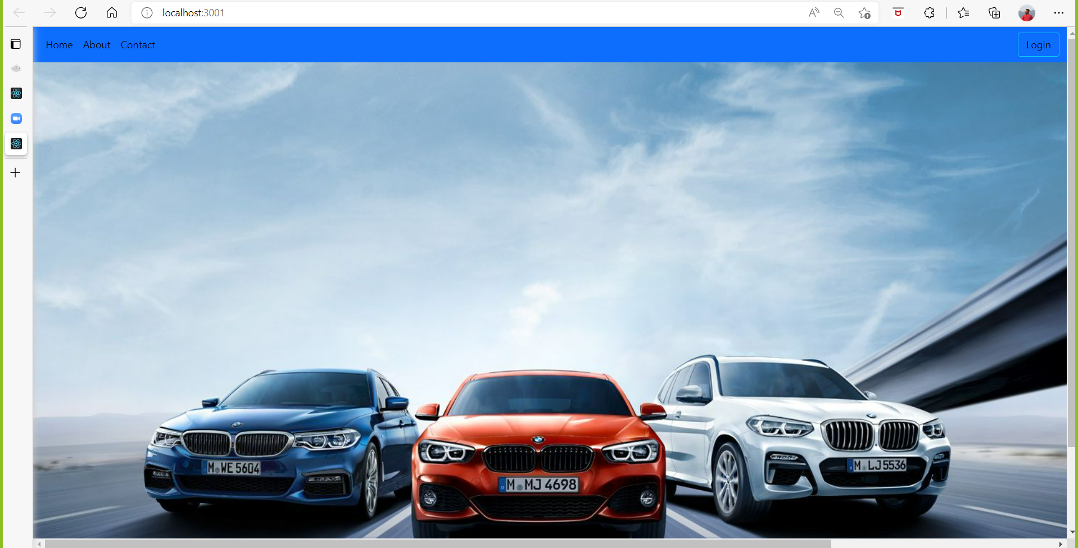

Slide 21
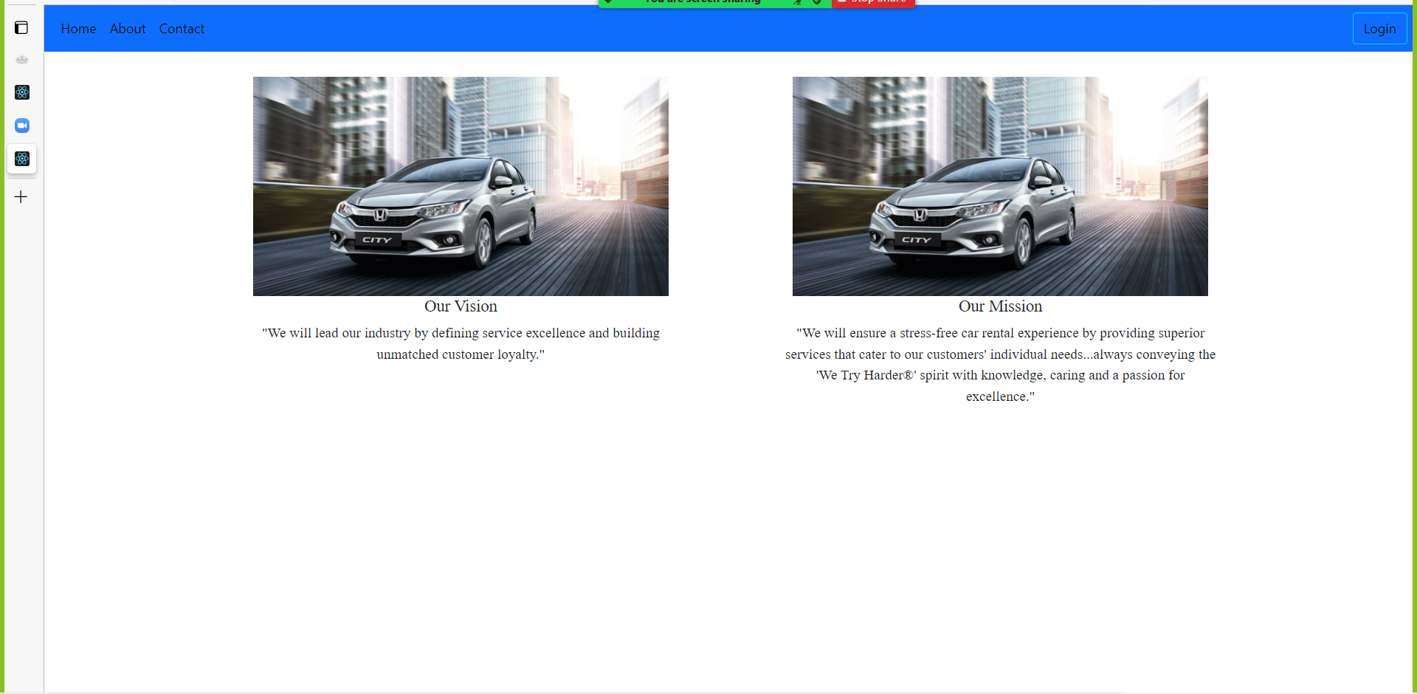

Slide 22
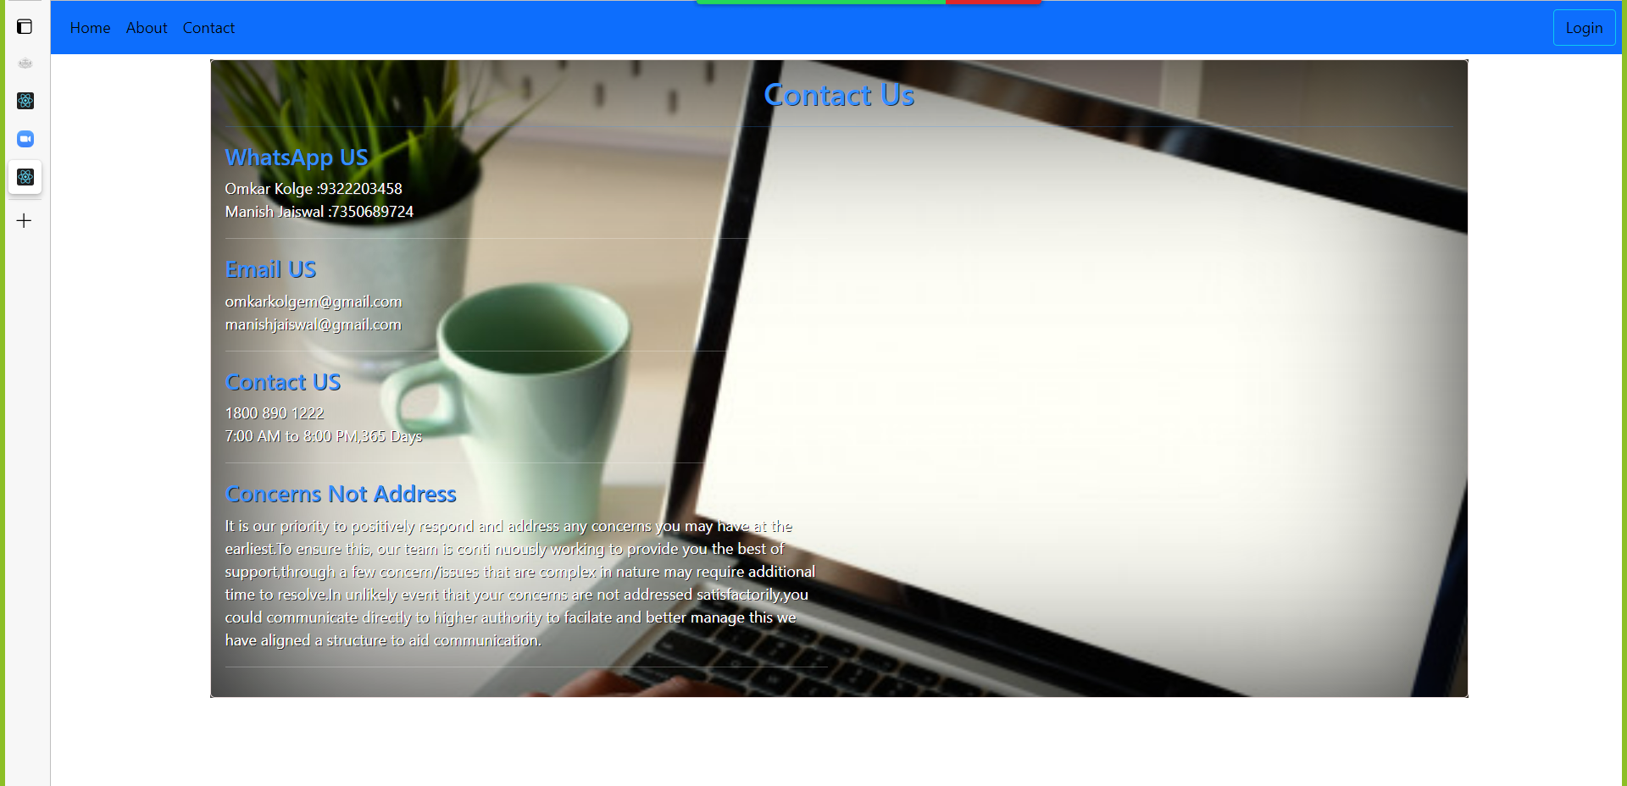

Slide 23
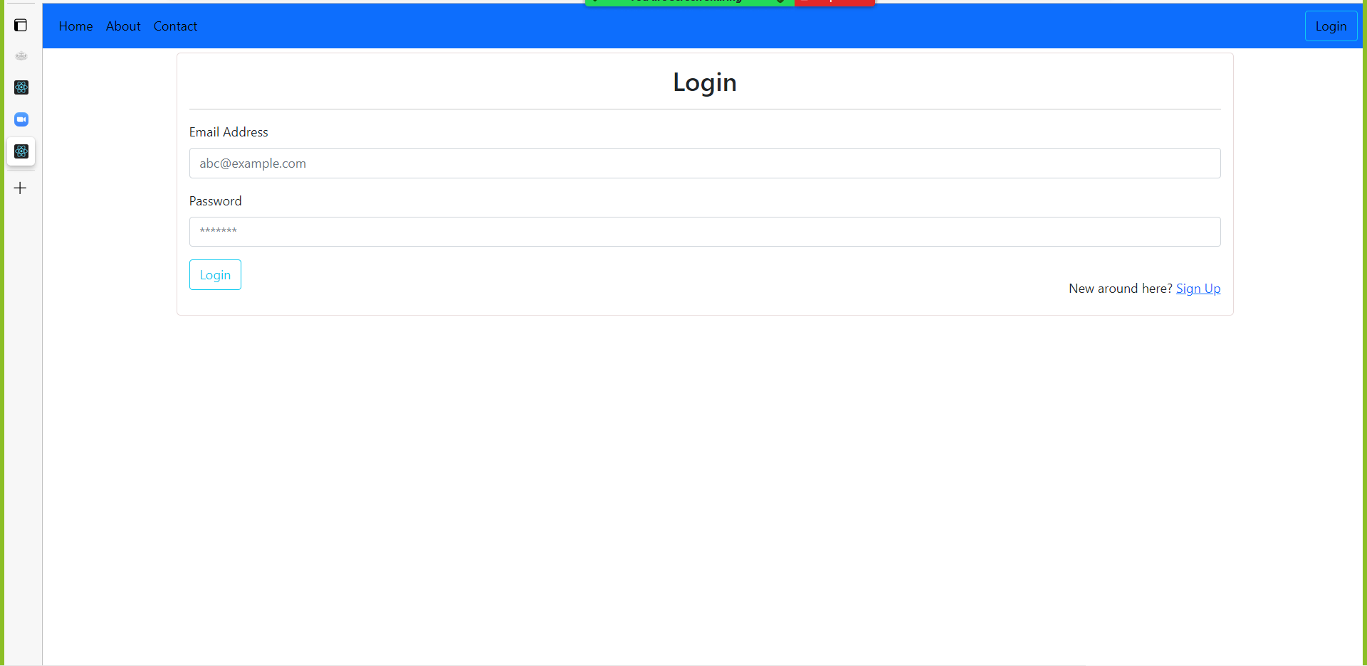

Slide 24
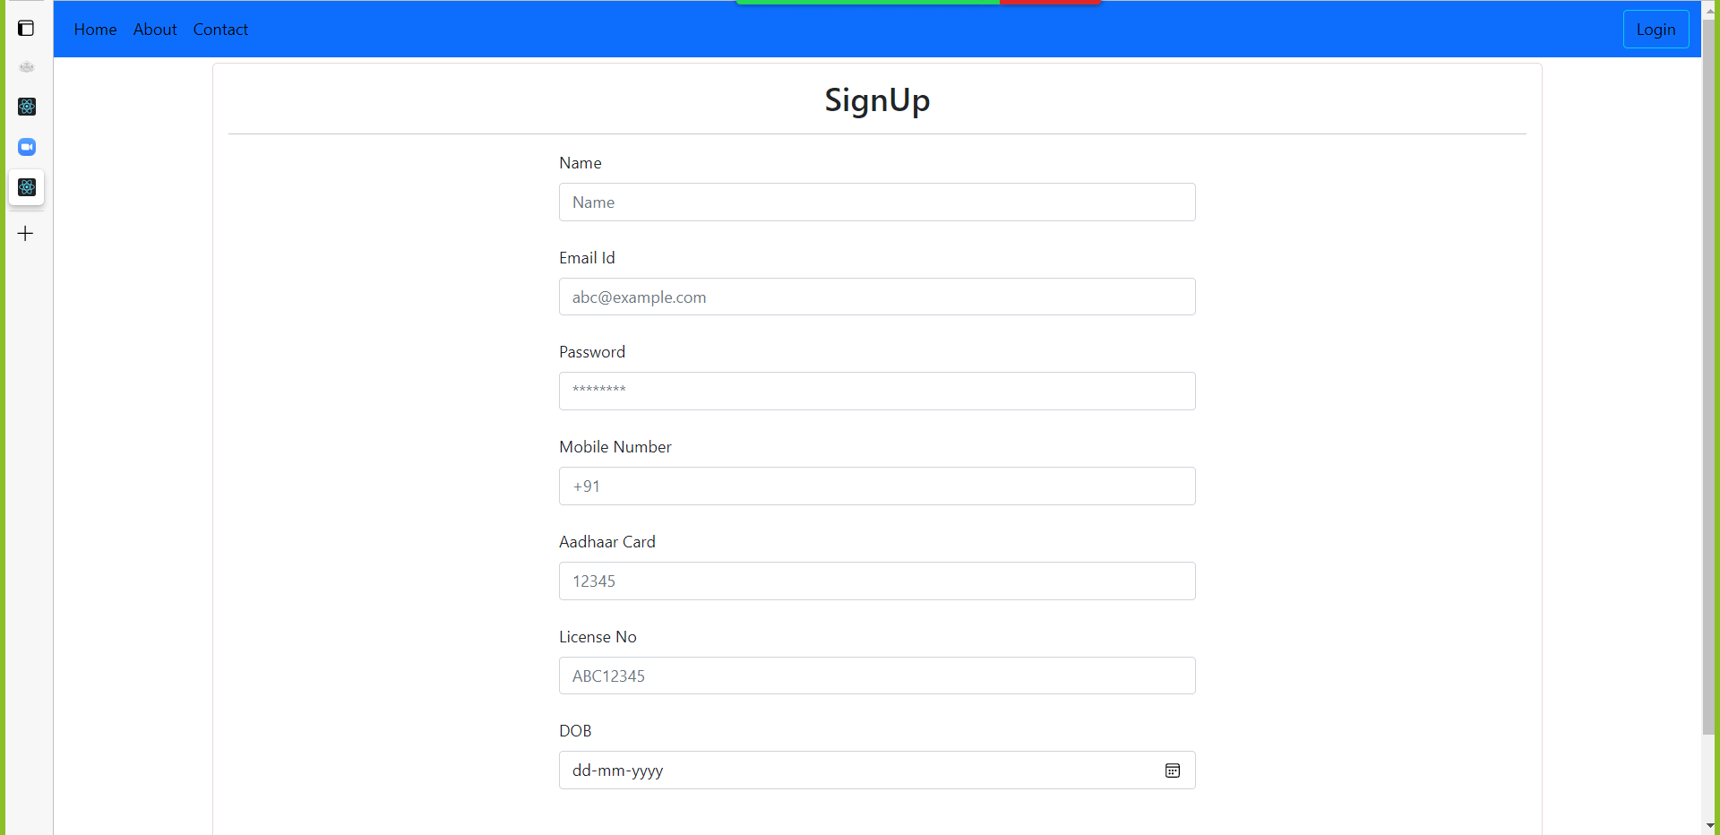

Slide 25
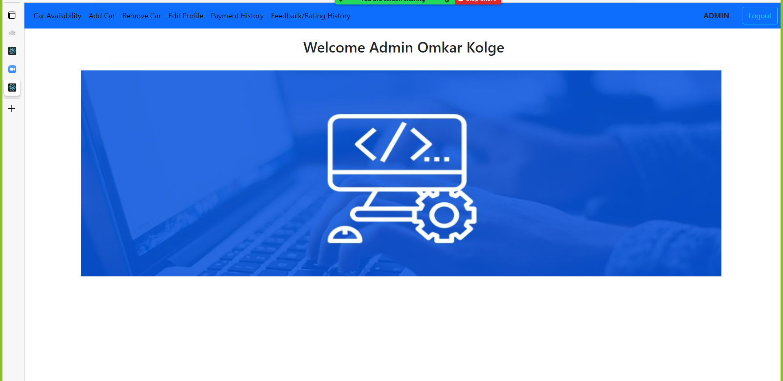

Slide 26
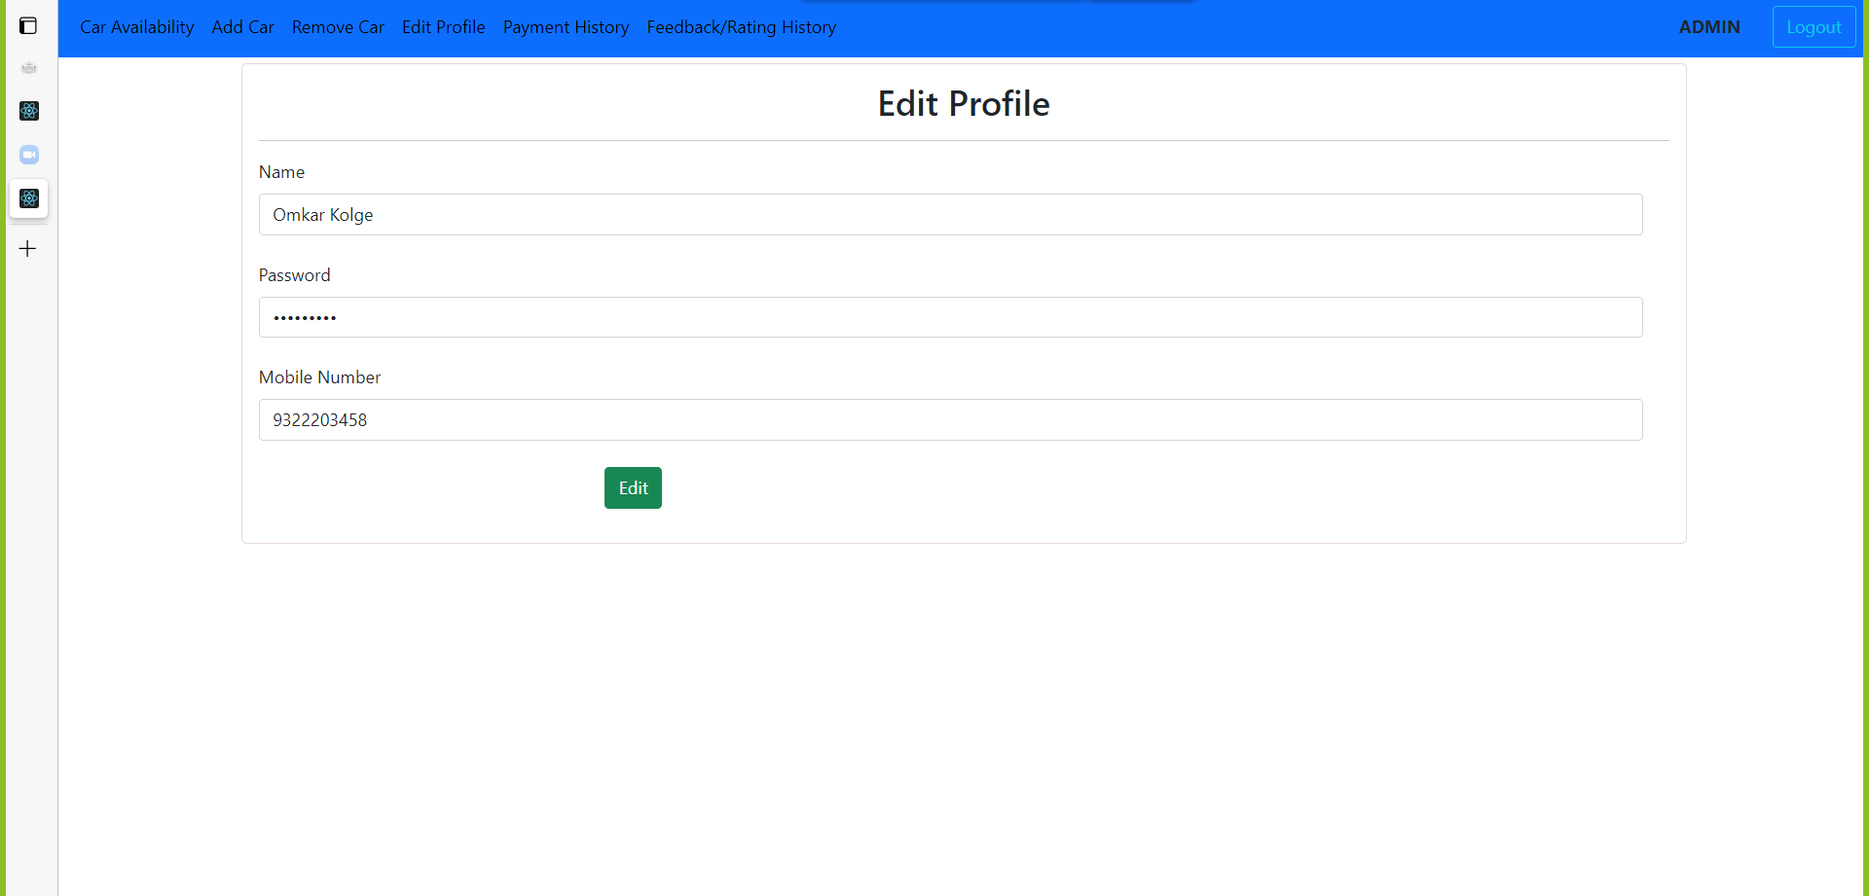

Slide 27
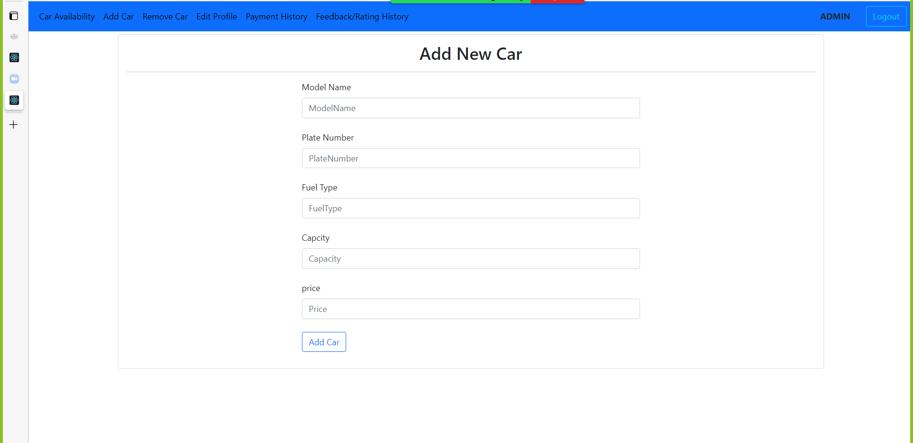

Slide 28
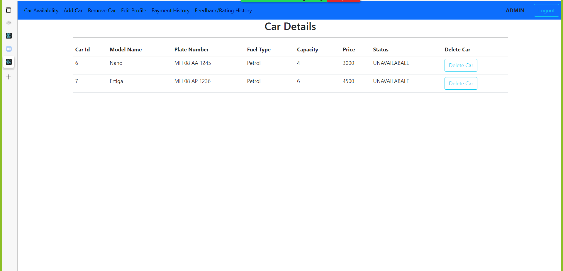

Slide 29
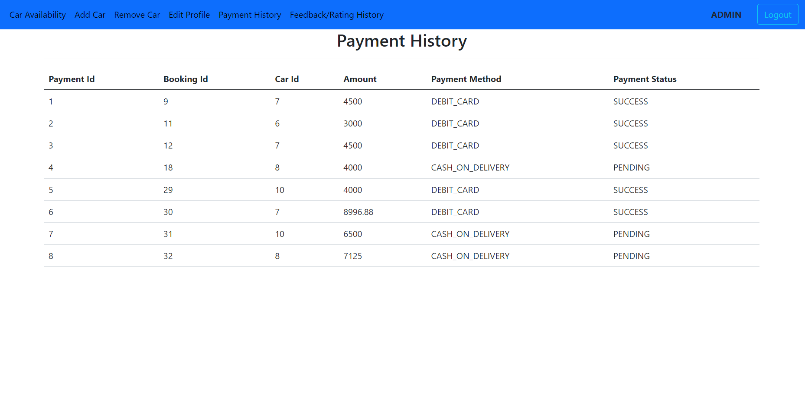

Slide 30
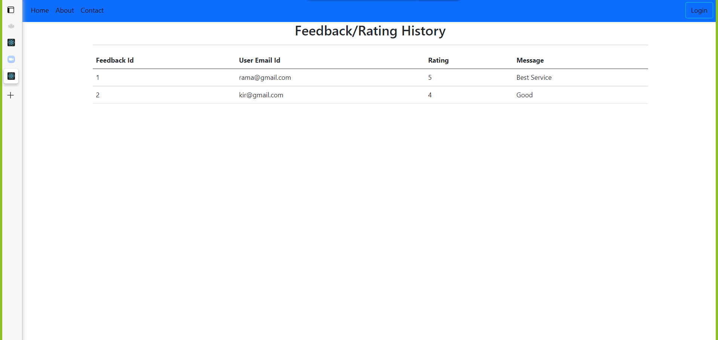

Slide 31
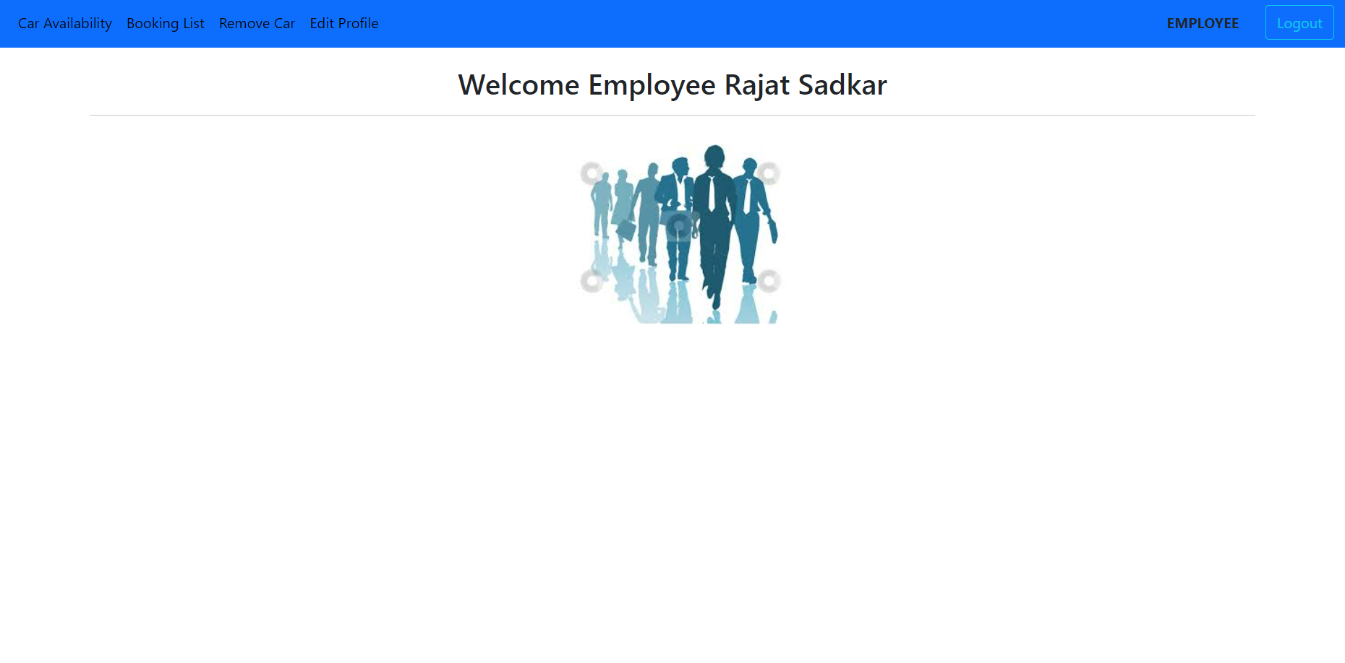

Slide 32
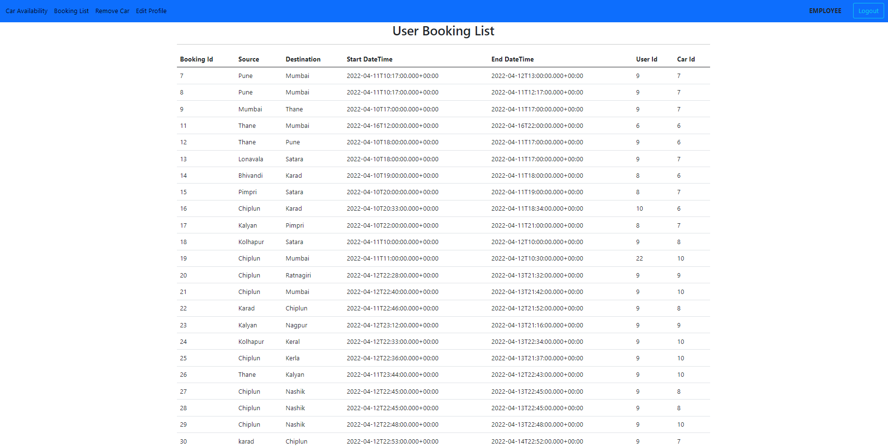

Slide 33
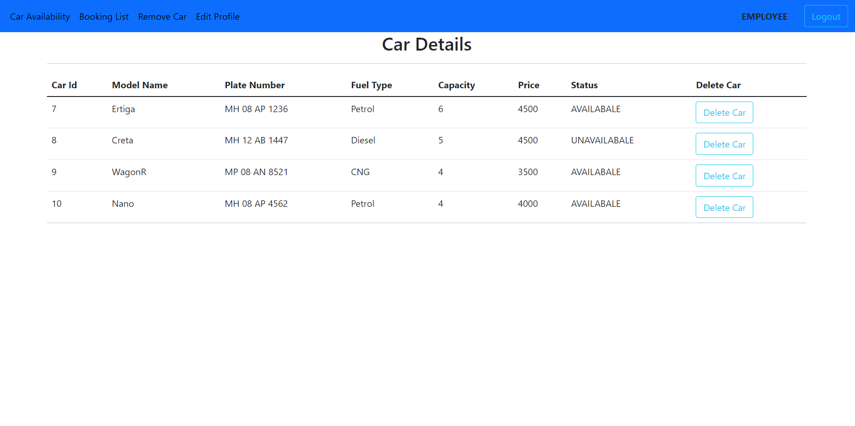

Slide 34
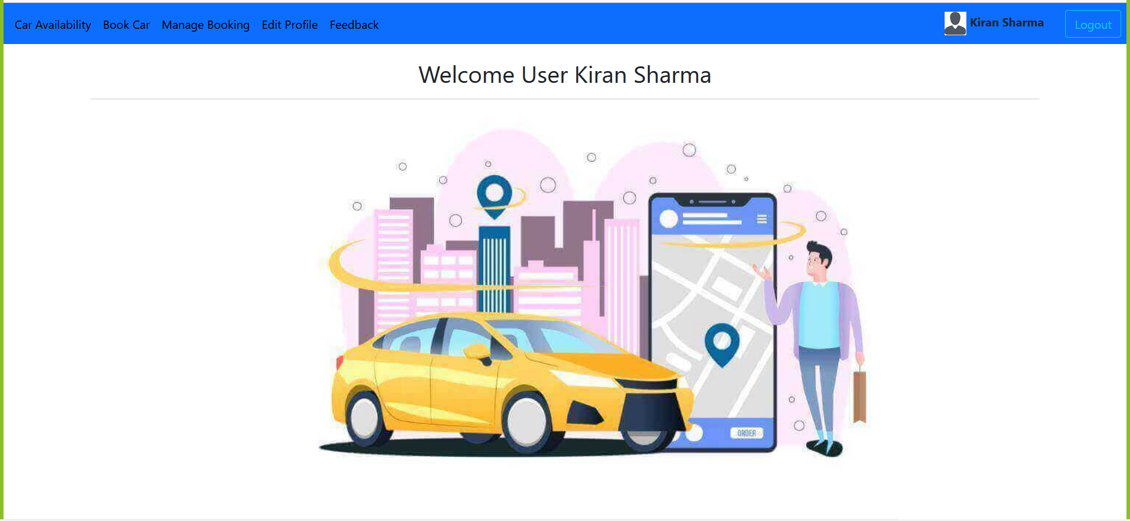

Slide 35
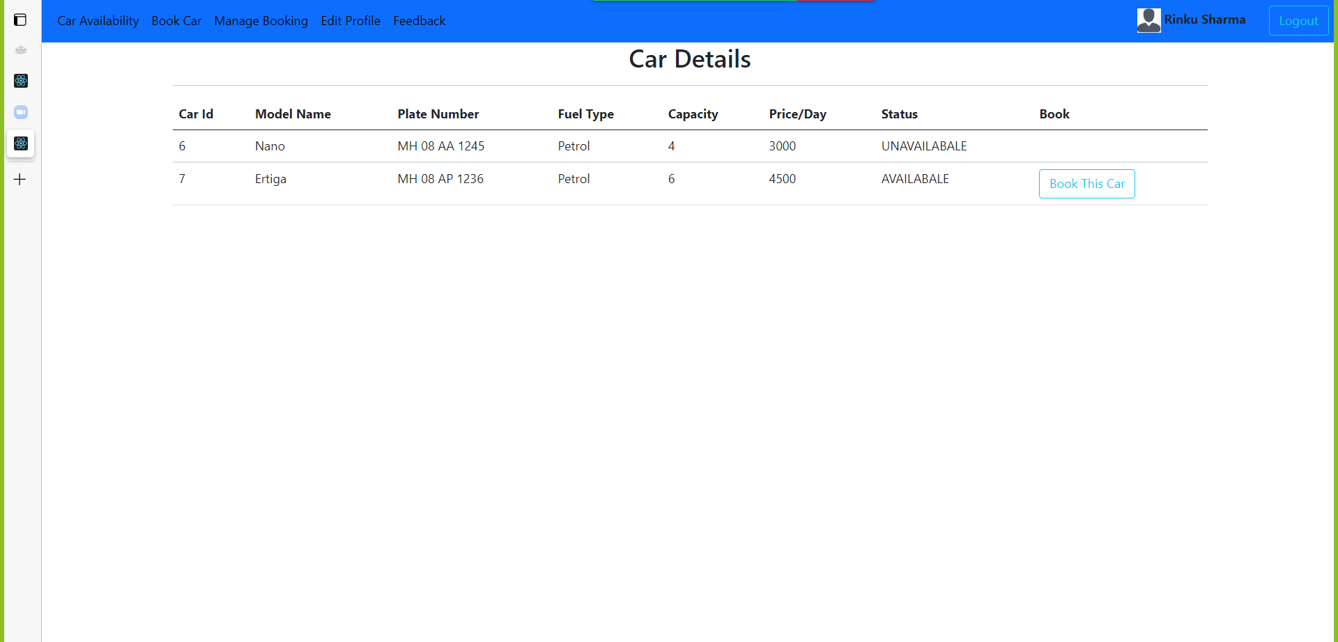

Slide 36
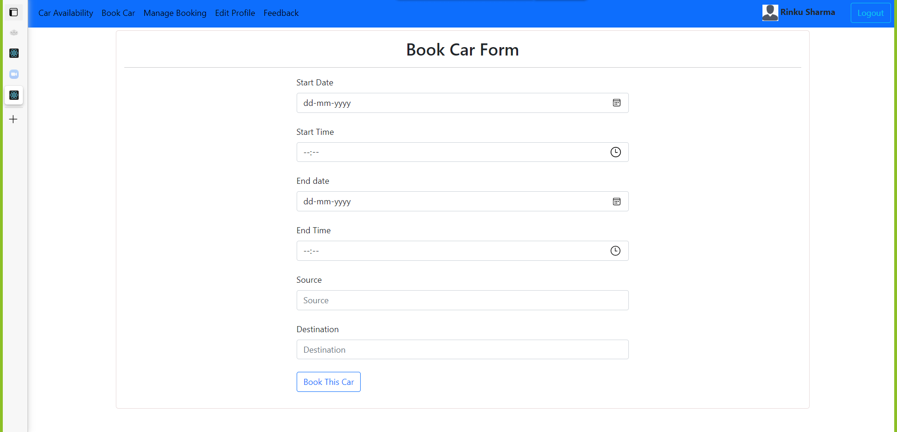

Slide 37
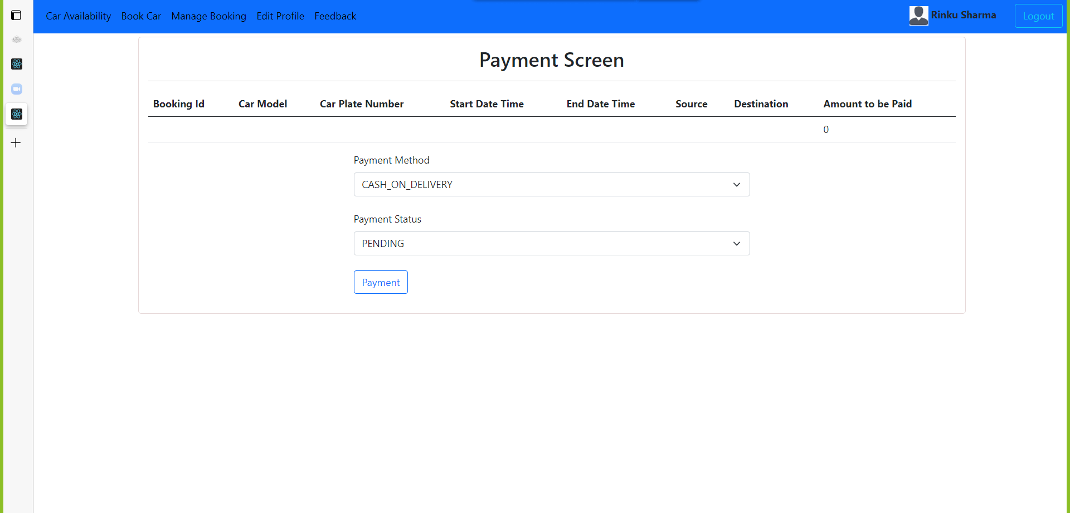

Slide 38
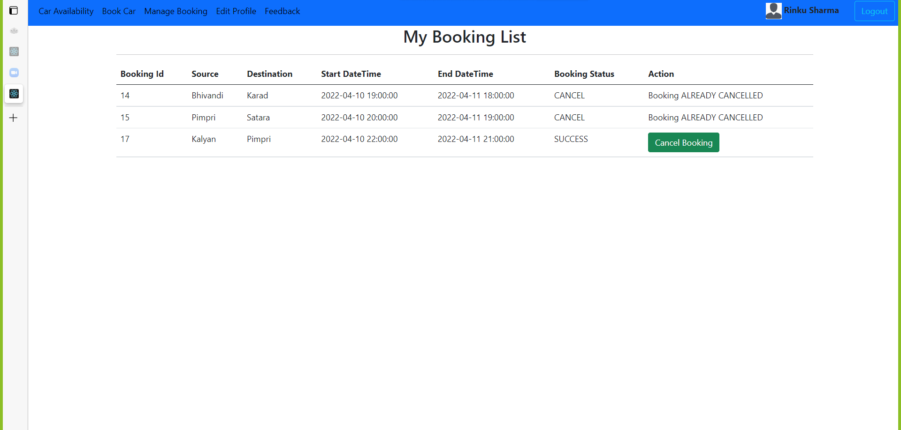

Slide 39
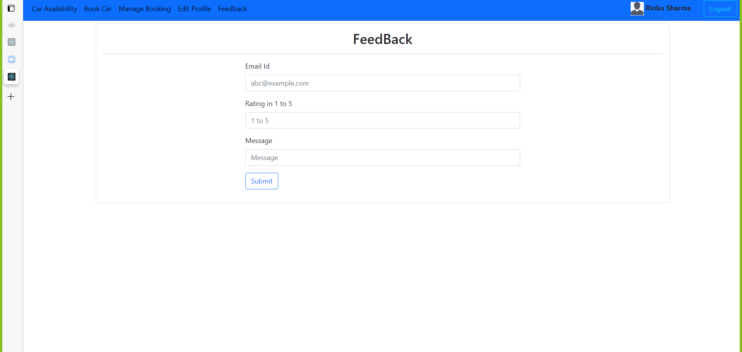

Slide 40
Thank You

